Slide 1

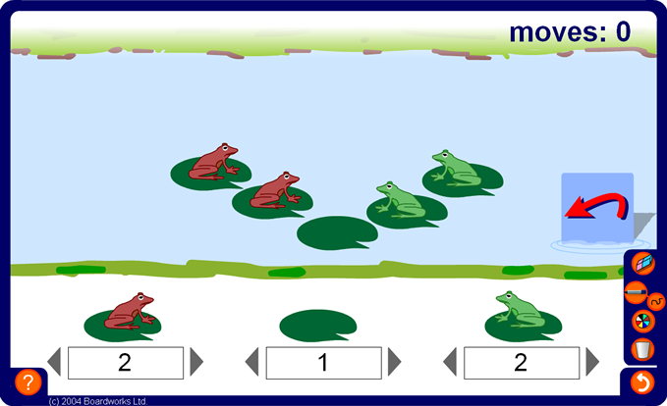

Leapfrog investigation
Notes:
Explain that the object of this investigation is to swap the frogs so that the green frogs are on the left and red frogs are on the right. A frog can only move in the direction it is facing. It can slide forward one place to an empty lily pad or it can jump over another frog provided there is an empty space behind it.
Start by developing a strategy to solve the puzzle. Note the number of slides and the number of jumps required.
Compete the puzzle for two frogs on each side and three frogs on each side. Ask pupils to predict the pattern of slides and jumps if we start with four frogs on each side.
Suggest to pupils that they could call the number of frogs on each side n and find the following formulae:
The number of slides in terms of n.
The number of jumps in terms of n.
The total number of moves in term of n.
Extend the activity by using different numbers of frogs on each side and by changing the number of empty lily pads in the middle.

